Slide 1
CIELAB Analysis Using Principle Component Analysis
Made By:-
Vaseem Ahmed Khan 2K10/IT/068

Slide 2
Introduction
Principal component analysis (PCA) is a mathematical procedure that uses an orthogonal transformation to convert a set of observations of possibly correlated variables into a set of values of linearly uncorrelated variables called principal components.
The number of principal components is less than or equal to the number of original variables.
PCA was invented in 1901 by Karl Pearson. Now it is mostly used as a tool in exploratory data analysis and for making predictive models.
PCA can be done by eigenvalue decomposition of a data covariance (or correlation) matrix or singular value decomposition of a data matrix, usually after mean centering (and normalizing or using Z-scores) the data matrix for each attribute.

Slide 3
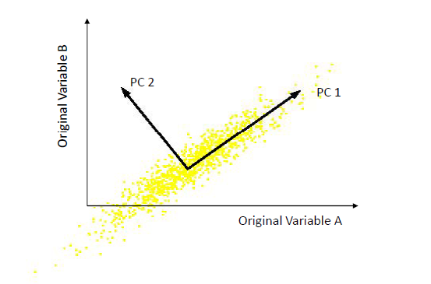
What are the new axes?
Orthogonal directions of greatest variance in data
Projections along PC1 discriminate the data most along any one axis

Slide 4
Principal Components
• First principal component is the direction of greatest variability (covariance) in the data
• Second is the next orthogonal (uncorrelated) direction of greatest variability
– So first remove all the variability along the first component, and then find the next direction of greatest variability!

Slide 5
Face recognition
A facial recognition system is a computer application for automatically identifying or verifying a person from a digital image or a video frame from a video source.
Eigenfaces are a set of eigenvectors used in the computer vision problem of human face recognition
A set of eigenfaces can be generated by performing a mathematical process called principal component analysis (PCA) on a large set of images depicting different human faces

Slide 6
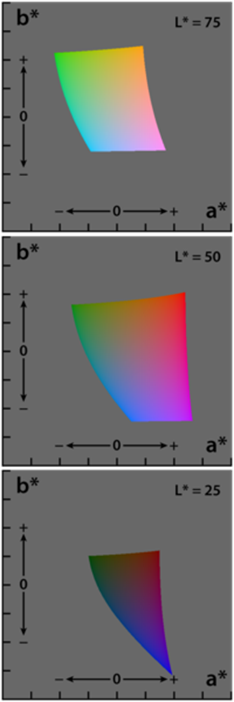
CIELAB
A Lab color space is a color-opponent space with dimension L for lightness and a and b for the color-opponent dimensions.
The three coordinates of CIELAB represent the lightness of the color (L* = 0 yields black and L* = 100 indicates diffuse white; specular white may be higher), its position between red/magenta and green (a*, negative values indicate green while positive values indicate magenta) and its position between yellow and blue (b*, negative values indicate blue and positive values indicate yellow).

Slide 7

Euclidean Distance
The Euclidean distance or Euclidean metric is the "ordinary" distance between two points that one would measure with a ruler, and is given by the Pythagorean formula.
In Cartesian coordinates, if p = (p1, p2,..., pn) and q = (q1, q2,..., qn) are two points in Euclidean n-space, then the distance from p to q, or from q to p is given by:

Slide 8
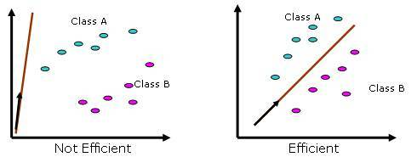
Working Methodology
The Principal Components (or Eigenvectors) basically seek directions in which it is more efficient to represent the data. This is particularly useful for reducing the computational effort.
To understand this, suppose we get 60 such directions, out of these about 40 might be insignificant and only 20 might represent the variation in data significantly, so for calculations it would work quite well to only use the 20 and leave out the rest.

Slide 9
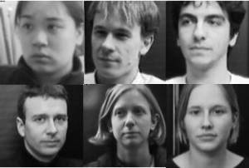
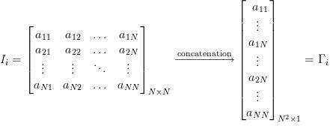
Algorithm for Finding Eigenfaces
1. Obtain training images ,I1,I2…I_{M}, it is very important that the images are centered.
2.Represent each image I_{i} as a vector as discussed above.

Slide 10

3.Find the average face vector .
4. Subtract the mean face from each face vector to get a set of vectors . The purpose of subtracting the mean image from each image vector is to be left with only the distinguishing features from each face and “removing” in a way information that is common.
5. Find the Covariance matrix : :
where
(Note that the Covariance matrix has simply been made by putting one modified image vector obtained in one column each.)

Slide 11
6. We now need to calculate the Eigenvectors of , However note that is a matrix and it would return Eigenvectors each being dimensional. For an image this number is HUGE. The computations required would easily make your system run out of memory. How do we get around this problem?
7
8. Find the best eigenvectors of

Slide 12
Algorithm for CIELAB Analysis
Obtain several data sets X_{i}’s,Y_{i}’s of several images and test image, containing any two features of CIELAB, say A,B respectively, using matlab’s inbuilt functions.
Calculate eigenvalues and subsequently eigenvectors for all these data sets using PCA method.
Using the eigenvector of the test image and those of the other images, taken one at a time, calculate the euclidean distance between them. The minimum Euclidean distance gives the closest features matching images.
Repeat the above steps for other features of CIELAB, LA and LB.
Decide the best feature among these by analysing the obtained minimum Euclidean distance and the actual similarity of images.

Slide 13
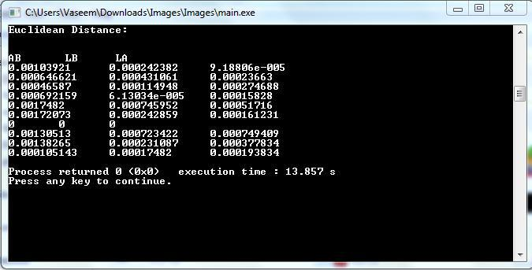
Conclusion

Slide 14
Ten facial images were taken and converted to data sets containing two features out of CIELAB, AB,LA & LB respectively.
Then, PCA analysis was conducted on all data sets to generate their respective eigenvectors, which were used to calculate euclidean distance between test image and other images.
Closest match was obtained in case of A,B features, indicated by the minimum euclid distance, thereby proving that A,B is the best 2-D feature combination present in CIELAB.

Slide 15
Scope and Applications

Slide 16
Wine Colour Measurement
Colour is one of the principal parameters of the quality of wine and it is the first sensory property to be perceived in the glass by a consumer, winemaker or wineshow judge.
In wineries, routine analysis of wine colour is generally performed using absorbance measurements by Somers or Glories methods, or by transmittance values (OIV method) at two to four wavelengths. However, the information provided is limited as the colour the eye perceives covers the full visible spectrum (380 nm ñ 770 nm).
Using the whole visible spectrum, the Commission Internationale de líEclairage (CIE) has established a three dimensional colour space defined by L*, a* and b* values, which represent lightness, red-green and yellow-blue characteristics, respectively.
With the CIELab parameters, the colour of wine can be measured precisely determined unambiguously, and differences to a colour standard can be quantified. Thus, CIELab colour measurements are used extensively by many industries and are gaining greater use as descriptors for colour by the wine industry.

Slide 17
Various applications in Face Recognition
Security measure at Air ports,
Passport verification,
Criminals list verification in police department,
Visa processing ,
Verification of Electoral identification
Card Security measure at ATM’s

Slide 18
References
Face Recognition Using Eigenfaces, Matthew A. Turk and Alex P. Pentland, MIT Vision and Modeling Lab, CVPR ’91.
Eigenfaces Versus Fischerfaces : Recognition using Class Specific Linear Projection, Belhumeur, Hespanha, Kreigman, PAMI ’97.
Eigenfaces for Recognition, Matthew A. Turk and Alex P. Pentland, Journal of Cognitive Neuroscience ’91.
B.K.Gunturk, A.U.Batur and Y.Altunbasak,(2003) “Eigenface-domain super resolution for face recognition,” IEEE Transactions of Image Processing

Slide 19


